Slide 1

An analysis of neologistic derogatory terms and their uses within common crawl
Harrison Bennion
2131296
Notes:
Hello and welcome, my name is Harrison Bennion. This presentation is based on my dissertation titled …

Slide 2
AGENDA
Project overview
Context
Implementation
Evaluation
​Conclusion​
Notes:
We’re going to be talking through my project in the following format, following the general flow of the paper

Slide 3
Project overview
Project aims
Datasets
Project aims to investigate unusual slurs within the internet, creating a classification for neologies
Locate and investigate websites of forums where the unusual slurs are being used
Investigating how terms are being used, and whether they are being used in a reclamatory sense
Urban Dictionary – Crowd-sourced dictionary for mostly English-language terms that are not captured by traditional dictionaries (Wilson et al., 2020)
Common Crawl – open-source archive of webpages from multiple years. Scraped automatically by bots and uploaded every few months
Notes:
The project had three main aims
To define an unusual/neologistic slurs
Investigate where they are being used within the internet
To determine legitimate uses or reclamatory uses of said terms
Data
Urban Dictionary, an informal crowd-sourced dataset which don’t appear in traditional dictionaries, E.g. today’s definition: Blursday (The day you are presently living, but have no idea what day it actually is)
Interesting columns are: word, definition, example, upvotes and downvotes
Common Crawl – collection of the internet, multiple scrapes a year, allows URL, metadata and raw text data access – good source for looking through data

Slide 4
Context
Derogatory terms and insulting language
Derogatory terms are typically used to either insult a group of people, to insult a non-typical group, or in a reclamatory manner – Croom, 2013
They can be classified in a variety of degrees, with Martinez et al., 2013, creating a 24-case taxonomy to break down terms into groups
Neologisms
New terms continuous crop up over time, with terms gaining new definitions
Bogetić, 2022, studied the language of incel forums, creating their own cryptolect
Undesirable content within datasets
Luccioni and Viviano, 2021, found biases and undesirable content within text datasets cam have a large impact on NLP embeddings
Abusive language detection
Number of methods for detection. Luccioni and Viviano, 2021 found many models favour different aspects of language detection
Notes:
Project context and related papers
Derogatory language has lots of ways it can be cut up
Croom says slurs and derogatory language typically use to either insult a typical group, a non-typical group or in a reclamatory sense
Martinez et al made a 24-case taxonomy allows for a finer breakdown
Neologisms are new terms which crop up over time.
Bogetic studied involuntary celibate forums and their use of very unique language, creating their own cryptolect like red pill, black pill, blue pilled etc in reference to the matrix
Luccioni and Viviano found undesirable content within many datasets used in NLP
Lots of news stories relating to bots being shut down due to insulting language and undesirable behaviour which are learnt through social media -> they are a product of their environment
Many models out there prefer different aspects of language

Slide 5
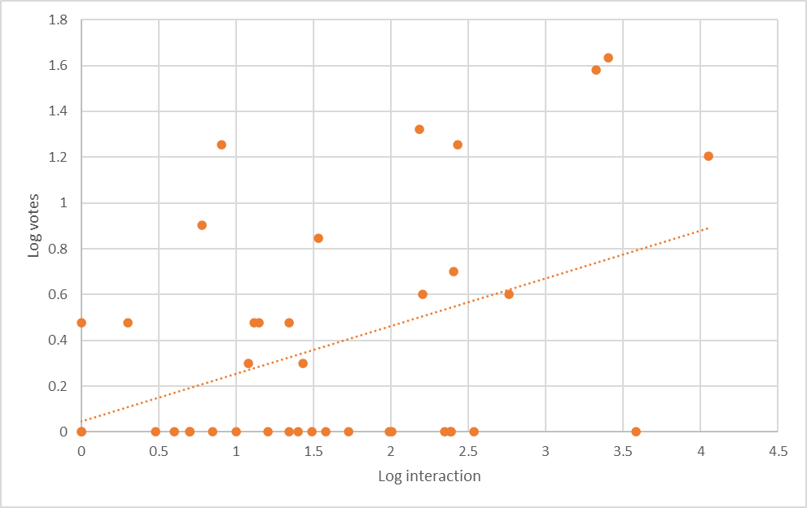





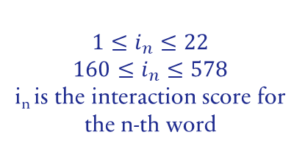
Implementation
Initial term extraction
Participant survey
Unusual slur datasets
Common Crawl search
Sentiment analysis
Regular expressions used to extract terms from Urban Dictionary
Stratified sampling of extraction to create a survey, which was a presented as a lexicon quiz
Using votes from the survey with the interaction score, two subsets were created
Three searches with Common Crawl raw text – regular expressions searched text for matches
Analysed matches using KMeans clustering and VADER methods
$$1≤i_{n}≤22$$
$$160≤i_{n}≤578$$
i_{n} is the interaction score for the n-th word
Notes:
Design and implemented in 5 stages
Slur extraction was the initial removing of terms from UD using regular expressions as a quick and easy method
Stratified sampling of extraction to create the survey – which was presented in the form of a lexicon quiz
Utilised votes alongside derived interaction and score values
Show graph
Trend moves upwards – created two subsets of slurs
Using these terms, searched common crawl’s raw text using regular expressions for matches
From this, we analysed these matches using KMeans clustering and VADER to detect sentiment

Slide 6
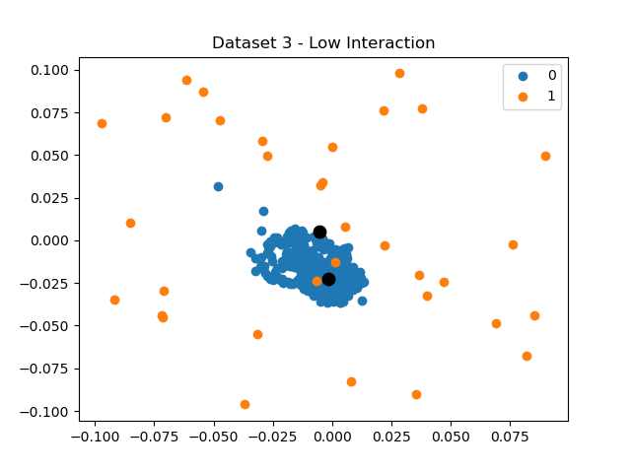
KMeans clustering
Common phrases were detecting using Gensim Phrases
Formatted sentences were compiled with Word2Vec to produce lower-dimensional vectors from the sentences
KMeans clustering produces two clusters – negative and positive
Sentiment coefficient calculated for each sentence using cluster label and proximity
TF-IDF score calculated for each word to see how unique words affect a sentence
Dot product of two produce a sentiment value for each sentence
Examples of negative sentiment examples:
“suburbs aarons_pass abbotsbury abbotsford abercrombie abercrombie river aberdare aberdeen aberfoyle”
“joseph calvin college_cambridge colleg_ cambridge jr_college camden county college cameron univ camp”
Clear issues with classifications with jumbled output and classification
Notes:
KMeans
Utilised gensim;’s phrases to detect common phrases and multi-words
Word2Vec compiled the found sentences into vectors of lower-dimension
These were clustered within KMeans – clear emphasis on central group with many sentences being found as positive
Followed this calculating two values
Sentiment coefficient used the label + proximity to cluster centre
Term Frequency-Inverse Document Frequency score for each word to show how unique each word was and how it effect the sentences
Dot product together got a general sentiment score
REMOVE PIC
Examples of –ve sentiment were quite chaotic, showing it needs quite a bit of work here

Slide 7
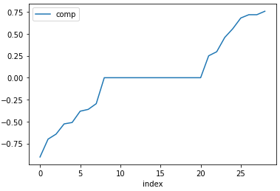
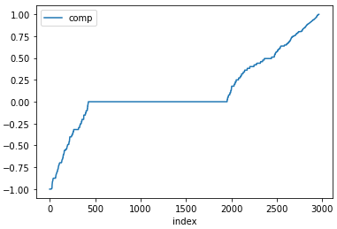
VADER model
VADER is a rule-based model that works well on social media and informal text styles
It can handle informal language like “LOL” or “WTF” amongst informal grammar like multiple exclamation marks within emphasise a point
Extremely efficient to run and so it could be applied on mass to Common Crawl data. Much faster than the KMeans model
Highly readable results allow for ease of analysis
Found number of pages and sentences containing abusive language when considering the high interaction dataset:
Chinless wonder – A forum insulting a comic book art thief
Douchtard – A comment about people lying about having a Tylenol allergy within ER
Meat gazer – Special Operations forum discussing all manner of things
Birdshit – A comment insulting the BBC drama Birdsong
But it wasn’t perfect as it had a preference for certain terms
Tabletop wargaming
Weapons or firearms etc.
Notes:
VADER – rule-based model that typically works well with informal and social media based language
Very efficient running at scale, could easily work again in the future if experiment done again
Very readable results – for each sentence, a positive, neutral, negative and compound score could be produced
Graph show distribution of compound score on all sentences ordered by compound – lots of neutral and +ve sents
REMOVE GRAPHS
Found a few pages containing insults being used an actual insults – chinless wonder, meat gazer and birdshit
Had issues with classification though as some neutral or reclamatory pages were tagged as negative due to their content used e.g. guns and tabletop gaming

Slide 8
Project evaluation
Extracting slurs and surveying participants
Searching common crawl and evaluating the matches
Regular expression extraction is a simplistic approach which relies heavily on the definition provided by the users
Issues with definition quality when the user interaction is low
Temporal issues between the survey date and the dictionary crawl date
Covid was defined as a legitimate derogatory term at this time
Removing the slurs that have non-derogatory alternative definitions decreased the false-positive matches, but removed legitimate insults
Similarly simplistic approach to extracting the slurs
Could utilize the sentiment analysis model during the search
Both models had a high number of positive sentiment matches
KMeans was significantly slower to run than VADER
VADER found insults being used legitimately within the high-interaction subset when enough data was gathered
These models were tested on a small scale compared to the sheer size of common crawl
Notes:
Extracting slurs was a very simple process which relies on accurate definitions being provided
Works at scale when many users vote on terms, like the definitions for an insult like “Fuck” which has a list of sorted definitions, whilst the lowest score is a ramble very few people agree with. Low interaction, which is what we’re looking and it is missing this moderation. This problem is only exacerbated now due to the removal of many moderators recently.
When it comes to the survey, there are clear differences between the survey creation and now – i.e. covid was an insult directed at children within the initial subset
We decreased false-positive matches, but at what cost?
Search was simplistic too, with much of the work being done in stages – could sentiment analysis live
Found a lot of positive sentiment, hard to analyse at scale but obvious we found a lot of matches which probably weren’t directed insults
Kmeans was slow and inaccurate, VADER was a lot better, but the work was on a very small scale. 200 files at 20% record rate out of 60000 potential files

Slide 9
Conclusion
Defined unusual slurs using the survey, but this is highly debatable and could be changed
Some pages using unusual insults were found, but it required a large amount of searching through these naïve method
Minor reclamatory examples found through analysis
Blog under the name Saxon Dog discussing tabletop gaming. Name is used in a reclamatory manner
Sentiment analysis models heavily emphasised certain terms like “devil” or “war”, but a bespoke model could prove more fruitful
Notes:
Looking back at the initial goals – found and defined unusual slurs using the survey, but this was at a small scale, and the actual definition could easily be moved or adapted
Found some insults, but naïve methods were used to trawl through a vast amount of data
Some reclamatory examples found through VADER – i.e. Saxon Dog
Many

Slide 10
Further work
Collecting websites with negative sentiment and searching for their appearances within Common Crawl
Collating links within these files and searching for more negative insults could allow a network to be built
Hate speech detection models could be used to extract slurs from matches
Exploring making use of the definition and examples within Urban Dictionary would be useful during sentiment analysis
Automatically deterring the difference between reclamatory and insulting terms
Notes:
Looking towards the future, there are quite a few different pathways which could be explored
Using the websites with negative sentiment – gathering their URLs and exploring Common Crawl to build a network, potentially studying how terms are disseminated
Hate speech detection models could be used within the matches to see if they are better at sentiment extraction
Using the definitions within UD to make a bespoke model
Currently the reclamatory terms were found by eye, an automated system using the sentiment would be good to explore

Slide 11
THANK YOU
Harrison Bennion
sy21479@bristol.ac.uk

